Slide 1
MCA473B – CYBER SECURITY

Slide 2
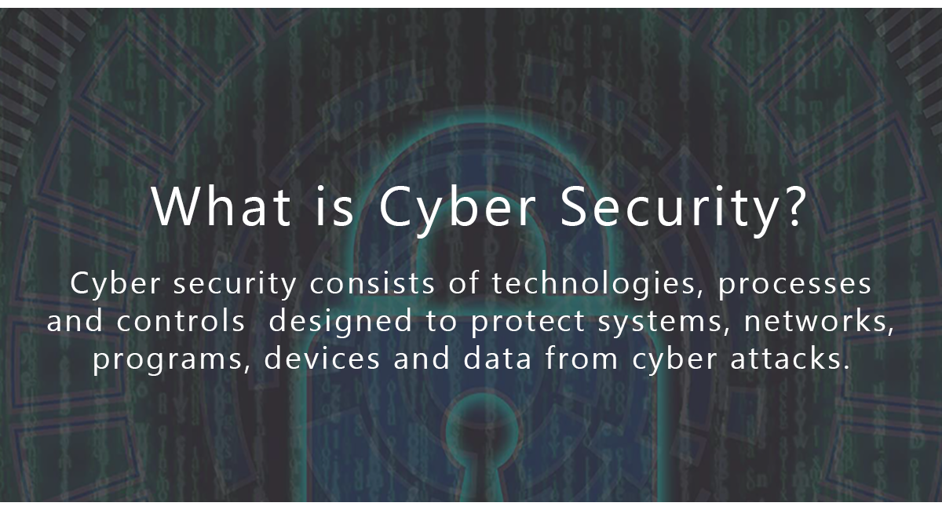
Cyber Security

Slide 3

Pre-requisites

Slide 4
Computer Fundamental – I/O, Process mgmt, Memory mgmt., Windows and Linux Platform
Computer Network – 90% of hacking based on network
Linux and Shell Programming
Programming

Slide 5


Useful platform to know more about cyber security Practically
OWSAP
Web Security Academy

Slide 6

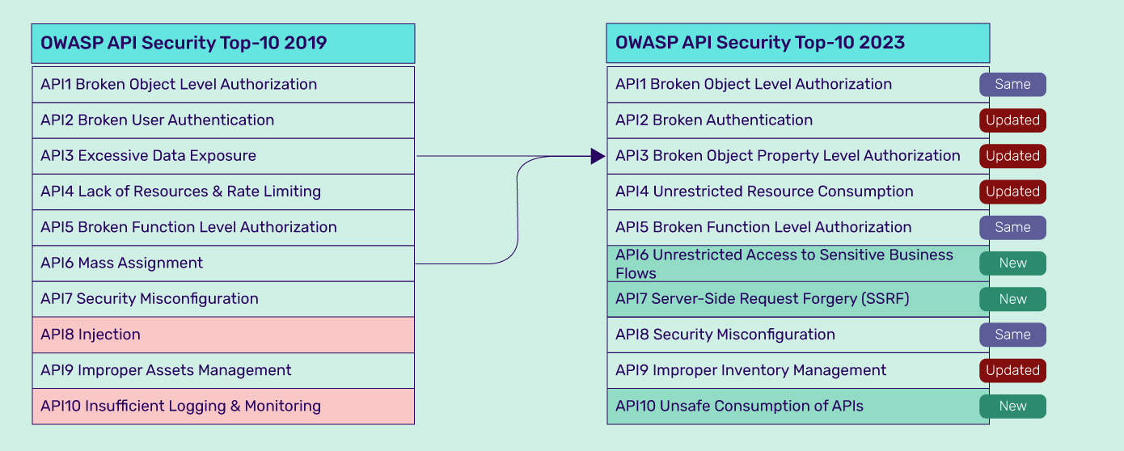

Slide 7
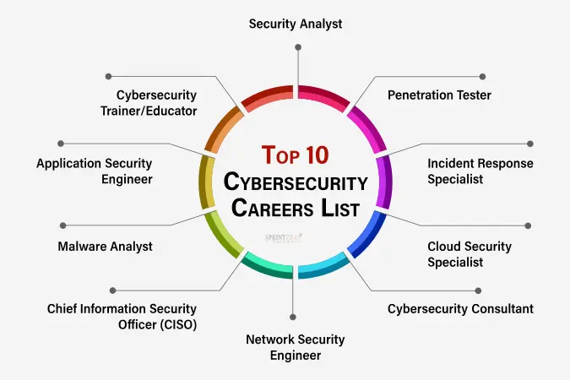

Slide 8
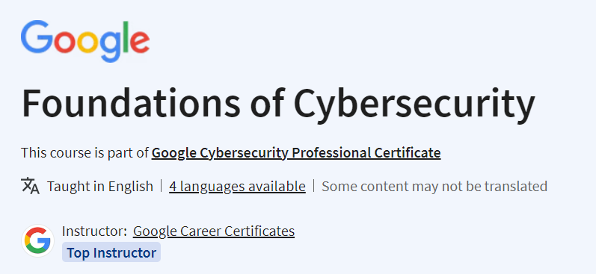
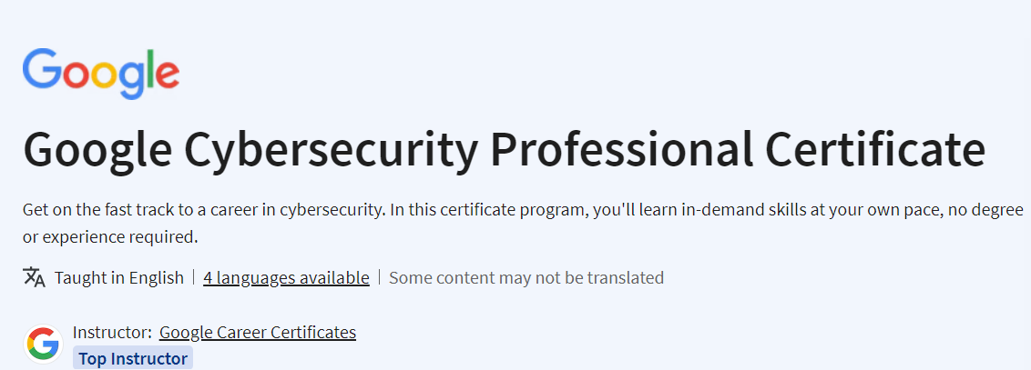
MOOC Courses

Slide 9
Security Problems & Maintaining Security in Cyber field
Viruses & Worms:
A virus is a program that is loaded into the computer without user’s knowledge and runs against the user’s wish.
Maintenance:
Install a security suite that protects the computer against threats such as viruses and worms. (eg., Antivirus)
Hackers:
A hacker is a person who uses computers to gain unauthorized access to data.

Slide 10
Types of Hackers
Black Hat Hackers: (Unethical Hacker or Security Cracker)
These people hack the system illegally to steal money or to achieve their own illegal goals.
They find the banks or organization with weak security and steal money or credit card information, they can also modify or destroy confidential data.
White Hat Hackers: (Ethical Hacker or Penetration Tester)
These people use the same technique used by the black hat hackers, but they can only hack the system that they have permission to hack in order to test the security of the system.
They focus on securing and protecting IT System. White Hat Hacker is legal.

Slide 11
Grey Hat Hackers:
Grey Hat Hackers are hybrid of Black hat hackers & White hat hackers
They can hack any system even if they don’t have permission to test the security of the system but they will never steal money or damage the system.

Slide 12
Maintenance:
It may be impossible to prevent computer hacking, however effective security controls including strong passwords and the use of firewalls.
Malware: (MALicious softWARE)
Malware is any software that infects and damages a computer system without the owner’s knowledge or permission.
Maintenance:
Download an anti-malware program that also helps prevent infection. Activate network protection firewall, antivirus.

Slide 13
Trojan Horse:
Trojan horse are email viruses that can duplicate themselves, steal information or harm the computer system. These viruses are the most serious threats to computers.
Maintenance:
Security suits such as Avast Internet Security, which will prevent from downloading Trojan Horses.

Slide 14
Password Cracking:
Password attacks are attacks by hackers that are able to determine passwords or find passwords to different protected electronic areas and social network sites.
Maintenance:
Use always strong password. Never use same password for two different sites.

Slide 15
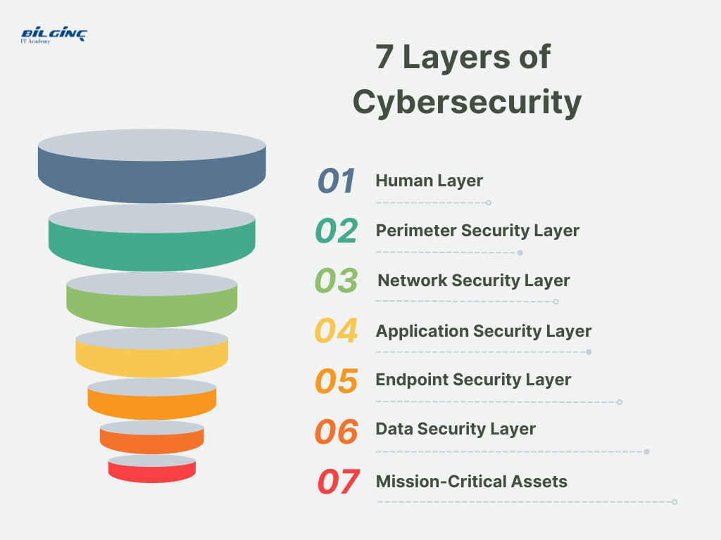
LAYERS OF SECURITY

Slide 16
The 7 layers of cyber security should center on the mission critical assets.
1. Mission Critical Assets: This is the data which need to be protected.
2. Data Security: It protects the storage and transfer of data.
3. Application Security: It protects access to an application which handles the mission critical assets and internal security of the application.
4. Endpoint Security: It protects the connection between devices and the network.

Slide 17
5. Network Security: It protects an organization’s network to prevent unauthorized access of the network.
6. Perimeter Security: It includes both the physical and digital security methodologies that protect the overall business.
7. The Human Layer: Humans are the weakest link in any cyber security posture. Human security control includes phishing simulations and access management control that protect mission critical assets from a wide variety of human threats, including cyber criminals, malicious insiders and negligent users.

Slide 18
Human Layer
The human layer, often regarded as the most vulnerable layer, focuses on the human element within an organization. It involves implementing practices and policies that ensure that employees, contractors, and other users do not fall victim to phishing attacks and other security threats due to human error or lack of knowledge.
Examples of human layer security measures include security awareness training, strong password policies, and multi-factor authentication, ensuring that users can identify and respond appropriately to security threats.

Slide 19
Perimeter Security Layer
Perimeter security layer is akin to the walls of a fortress. It serves to protect the network by controlling incoming and outgoing network traffic based on an organization's previously established security policies. At its core, it involves implementing firewalls, intrusion detection systems (IDS), intrusion prevention systems (IPS), and VPNs to create a barrier between your secure internal network and untrusted external networks such as the internet.
An example of how this works is a firewall that filters incoming traffic to allow or block packets based on the organization’s security policies, thus preventing unauthorized access to networked resources.

Slide 20
Network Layer
The network layer is crucial in managing and protecting the communication between applications and devices on your network.
This layer employs various security measures and controls to prevent attackers from intercepting and tampering with information as it travels over the network.
By securing the network layer through strategies like encryption, secure protocols, and robust network architectures, organizations can ensure the integrity, availability, and confidentiality of the transmitted information, thereby protecting against unauthorized access and potential cyberattacks, and maintaining seamless and secure organizational operations.

Slide 21
Application Security Layer
This layer focuses on keeping software and devices free of threats. Secure coding practices are vital here, as vulnerabilities in the application can serve as entry points for cyber threats.
Examples of application security measures include regular security scanning and testing to identify and remedy vulnerabilities and employing application security solutions like Web Application Firewalls (WAFs) to protect against threats such as SQL injection and Cross-Site Scripting (XSS).

Slide 22
Endpoint Security Layer
The endpoint security layer concentrates on safeguarding the individual devices that connect to the network, like computers, smartphones, and tablets.
Since these endpoints serve as access points to the network, securing them is crucial.
An example of endpoint security is employing antivirus programs and endpoint detection and response (EDR) solutions to monitor, detect, and block malicious activities and threats on endpoints, ensuring that even if a device is compromised, the threat does not propagate through the network.

Slide 23
Data Security Layer
This layer is dedicated to protecting the data residing in the network, focusing on maintaining its confidentiality, integrity, and availability.
Encryption is a prime example of a data security measure, where sensitive data is converted into a coded format to prevent unauthorized access.
Another example is employing backup solutions and establishing robust access controls to safeguard data from loss, exposure, and unauthorized access, ensuring only authorized personnel can access sensitive information.

Slide 24
Mission-Critical Assets
This layer focuses on safeguarding assets that are crucial to an organization's operations and business continuity. These could include proprietary software, sensitive customer data, or essential hardware.
For instance, regularly updating and patching mission-critical applications ensures that vulnerabilities are addressed, minimizing the risk of exploitation and ensuring the uninterrupted functionality of essential assets.

Slide 25
Vulnerability, Threats and Harmful Acts
Vulnerabilities are the gaps or weaknesses in a system that make threats possible and tempt threat actors to exploit them.
Types of vulnerabilities in network security:
SQL injections
Server misconfigurations
Cross-site scripting, and Transmitting sensitive data in a non- encrypted plain text format.

Slide 26
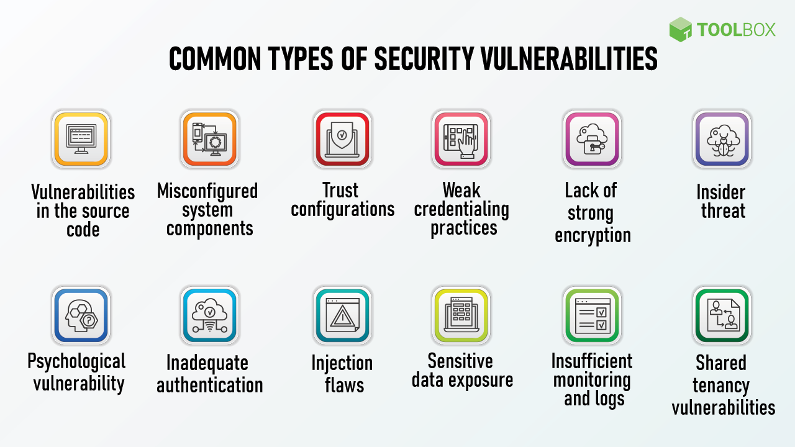

Slide 27
Cyber threats are security incidents or circumstances with the potential to have a negative outcome for your network or other data management systems.
Examples:
Phishing attacks that result in the installation of malware that infects your data, failure of a staff member to follow data protection protocols that cause a data breach, or even a tornado that takes down your company’s data headquarters, disrupting access. Vulnerabilities is not risk without a threat exploiting it. Threat is not a risk without a vulnerability to be exploited.

Slide 28
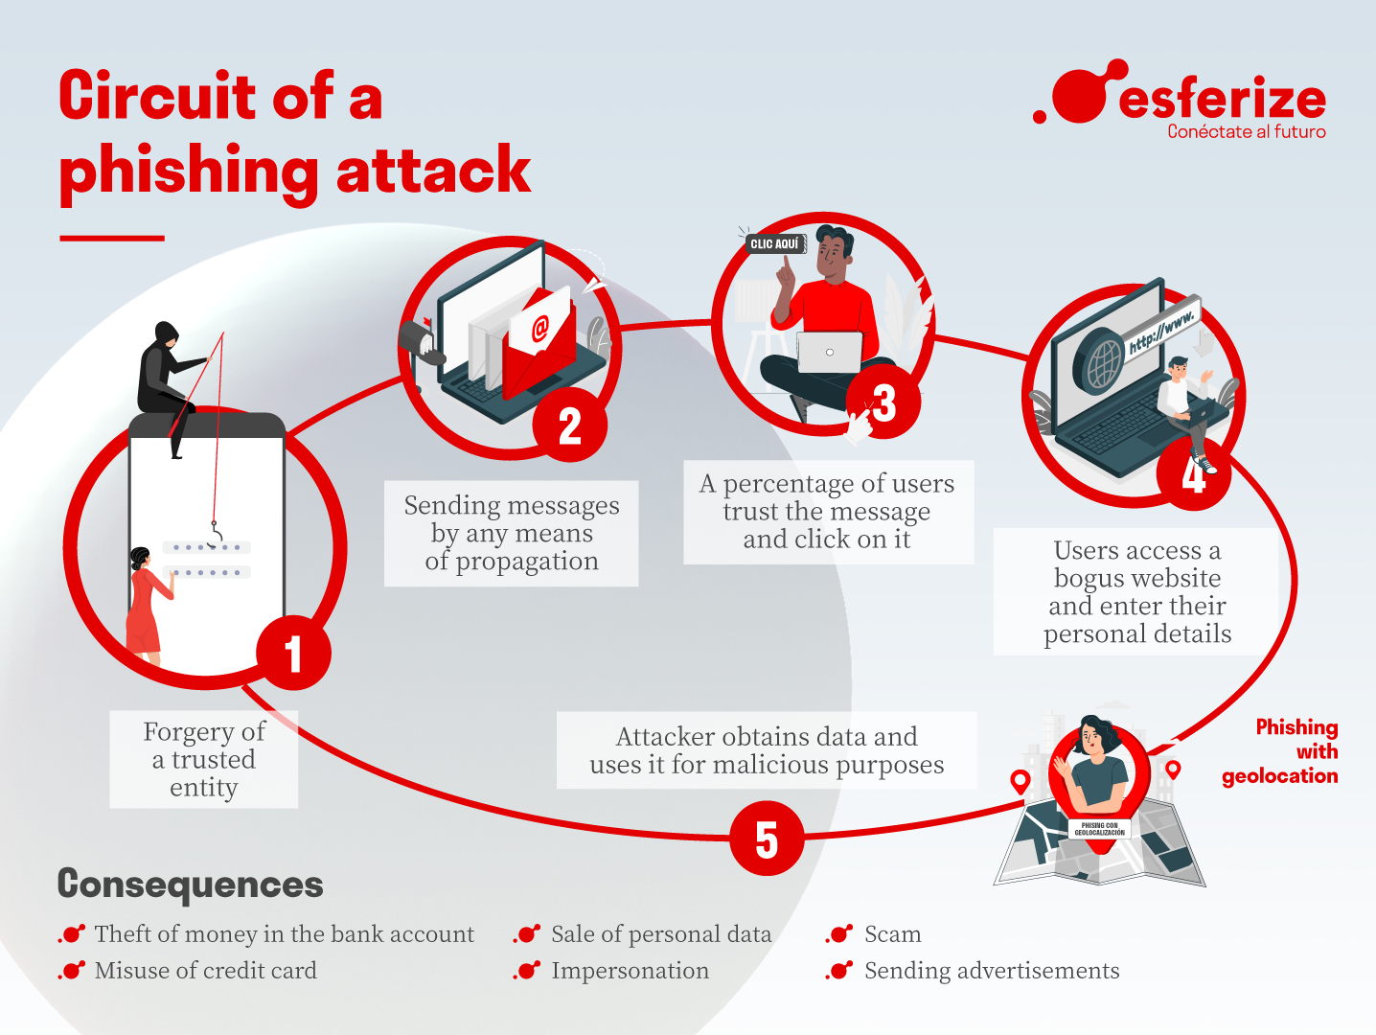

Slide 29
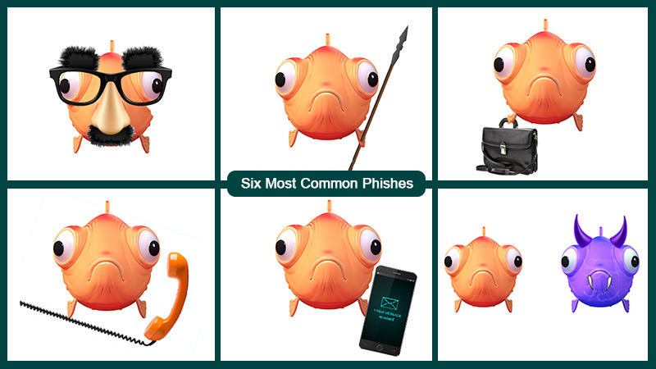

Slide 30
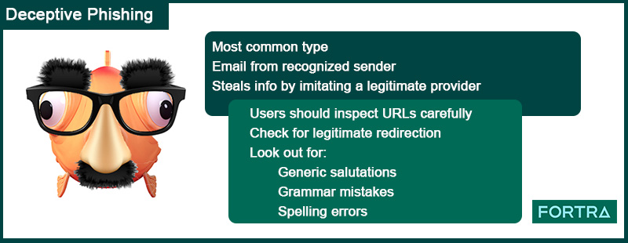

Slide 31
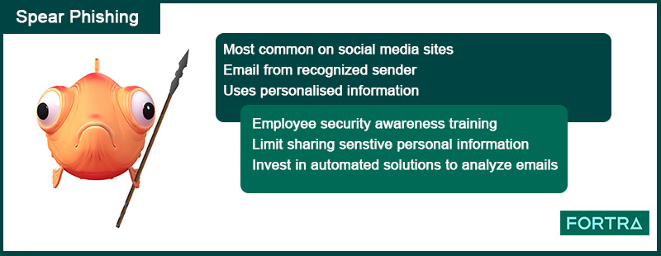

Slide 32
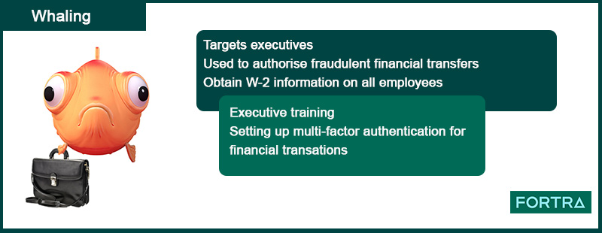

Slide 33
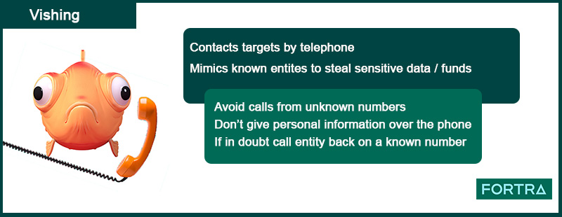

Slide 34
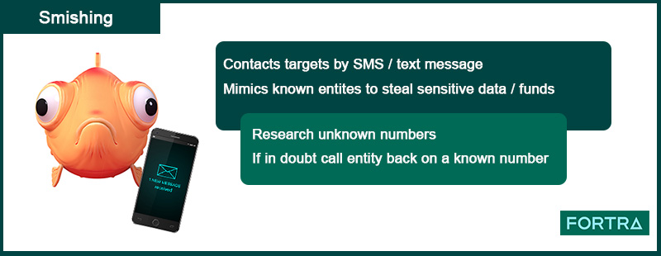

Slide 35
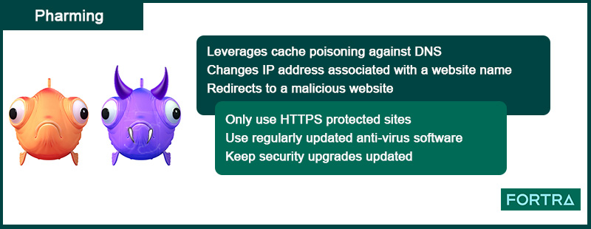

Slide 36
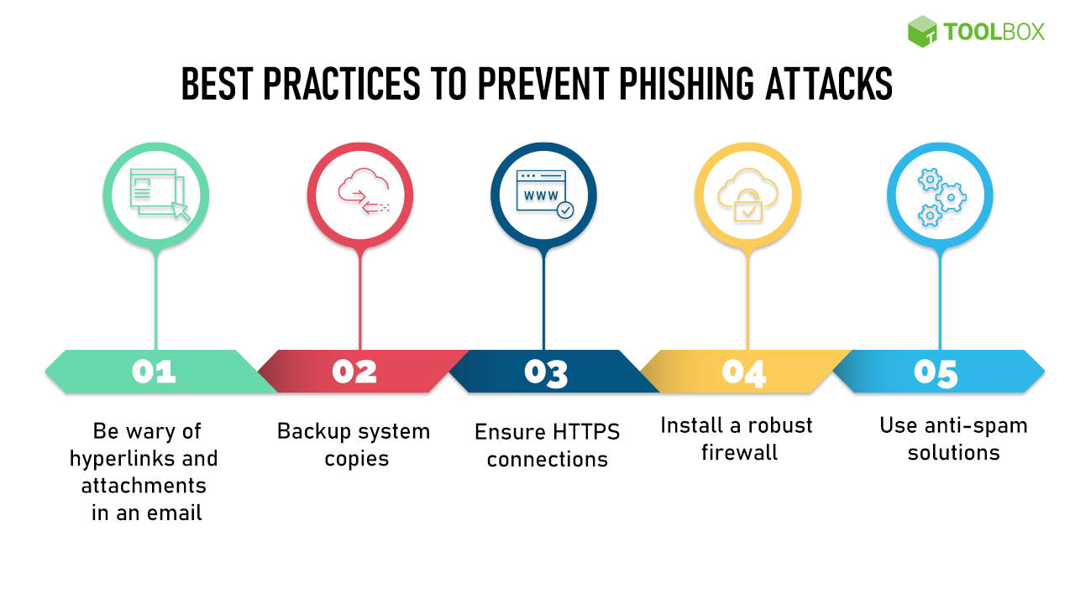

Slide 37
Internet Governance – Challenges and Constraints
Internet Governance is defined as the development and application by Government.
The private sector and civil sector in their respective roles of shared principles, norms, rules, decision making procedures and programs that shape the evolution and use of the Internet.

Slide 38
Internet Governance Actors:
According to the definition, there is no single organization in charge of the Internet but various stakeholders – Governments, Inter Governmental Organizations, the private sector, the technical community and Civil Society share roles and responsibilities in shaping the evolution and use of this network.
There are multiple actors which are involved in one way or another in the governance of Internet.
1. Internet Corporation for Assigned Names and Numbers (ICANN)
2. Internet Engineering Task Force (IETF)
3. International Telecommunication Union (ITU)
4. World Intellectual Property Organization (WIPO)
5. Internet Governance Forum (IGF)

Slide 39
Computer Criminals:
Computer crimes have quickly become one of the fastest rising forms of modern crime. According to cyber experts, approx., 1 million potential cyber-attacks are attempted per day.
Types of Cyber Criminals:
Cyber criminals are also known as hackers. Hackers are extremely difficult to identify on both individual and group level, due to their various security measures.

Slide 40
Identity Thieves:
Identity thieves are cyber criminals who try to gain access to their victim’s personal information. They use their information to make financial transaction while impersonating their victims. Identity theft is one of the oldest cybercrime.
Internet Stalkers:
Internet Stalkers are individuals who maliciously monitor the online activity of their victims to acquire personal information.
This form of cybercrime is conducted through the use of social networking platforms and malware, which are able to track an individual’s computer activity with very little detection.
Businesses should be aware of Internet Stalkers.

Slide 41
Phishing Scammers:
Phishing are cyber criminals who attempt to get hold of personal or sensitive information through victim’s computer.
This is often done via phishing websites that are designed to copycat small business, corporate or government websites.
Once such information is obtained, phishers either use the information themselves for identity fraud scams or sell it in the dark web.

Slide 42
Cyber Terrorists:
Cyber Terrorism is a well-developed politically inspired cyber-attack in which the cyber criminal attempts to steal data or corrupt corporate or Government computer systems and networks resulting in harm to countries, business, organizations and even individuals.
The key difference between an act of cyber terrorism and a regular cyber-attack is that within an attack of cyber terrorism, hackers are politically motivated as opposed to just seeking financial gain.

Slide 43
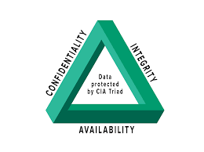
CIA Triad

Slide 44
Confidentiality
Protecting confidentiality is dependent on being able to define and enforce certain access levels for information. This process involves separating information into various collections that are organized by authorized user, who needs to access the information and how sensitive that information actually is - i.e. the amount of damage suffered if the confidentiality was breached.
Standard measures to establish confidentiality include:
Data Encryption
Two-factor authentication Biometric Verification
Security Tokens.

Slide 45
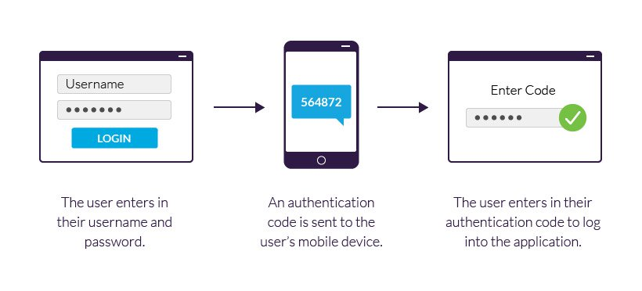

Slide 46
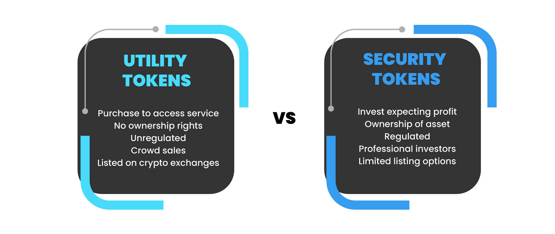

Slide 47
Integrity
This is an essential component of the CIA Triad and designed to protect data from deletion or modification from any unauthorized party, and it ensures that when an authorized person makes a change that should not have been made the damage can be reversed.
Standard measures to guarantee Integrity include:
Cryptography checksums
Using file permissions
Uninterrupted power supplies Data backups.

Slide 48
Availability
This is the final component of the CIA Triad and refers to the actual availability of your data. Authentication mechanisms, access channels and systems all have to work properly for the information they protect and ensure it's available when it is needed.
Standard measures to guarantee Availability include:
Backing up data to external drives
Implementing firewalls
Having backup power supplies
Data redundancy

Slide 49
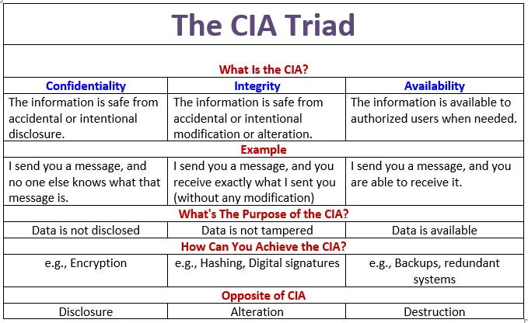

Slide 50
Assets and Threat
An asset is any data, device or other component of an organization’s systems that is valuable – often because it contains sensitive data or can be used to access such information.
For example: An employee’s desktop computer, laptop or company phone would be considered an asset, as would applications on those devices.
Likewise, critical infrastructure, such as servers and support systems, are assets. An organization’s most common assets are information assets. These are things such as databases and physical files – i.e. the sensitive data that you store

Slide 51
A threat is any incident that could negatively affect an asset – for example, if it’s lost, knocked offline or accessed by an unauthorized party.
Threats can be categorized as circumstances that compromise the confidentiality, integrity or availability of an asset, and can either be intentional or accidental.
Intentional threats include things such as criminal hacking or a malicious insider stealing information, whereas accidental threats generally involve employee error, a technical malfunction or an event that causes physical damage, such as a fire or natural disaster.

Slide 52
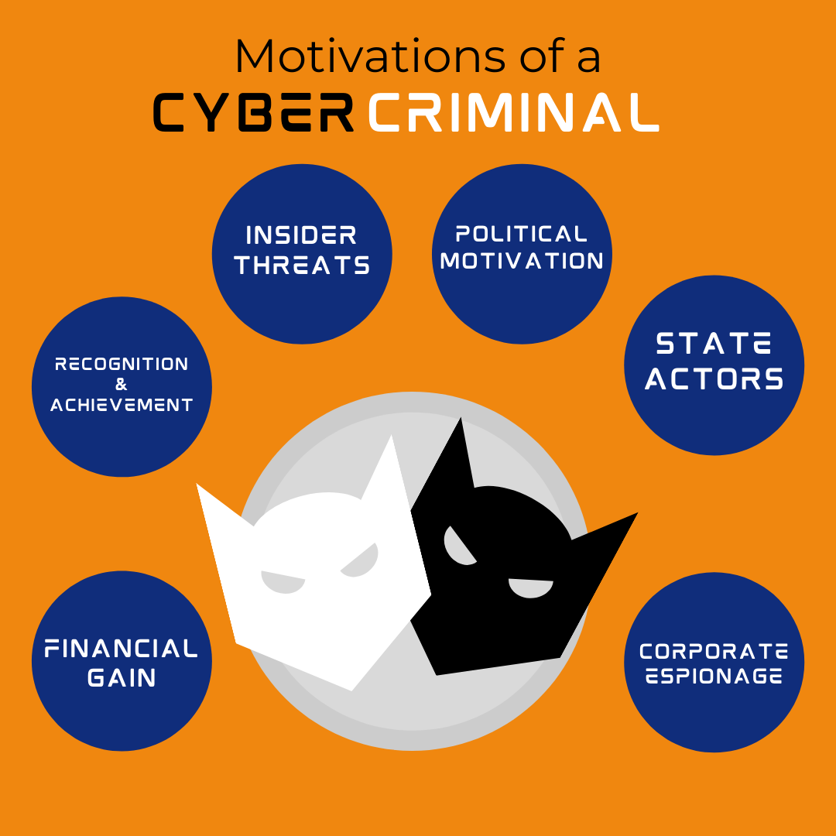
Motive of Attackers

Slide 53
Three types of actions:
i) inadvertent actions (generally by insiders) that are taken without malicious or harmful intent;
ii) deliberate actions (by insiders or outsiders) that are taken intentionally and are meant to do harm; and
iii) inaction (generally by insiders), such as a failure to act in a given situation, either because of a lack of appropriate skills, knowledge, guidance, or availability of the Correct person to take action Of primary concern here are deliberate actions, of which there are three categories of motivation.

Slide 54
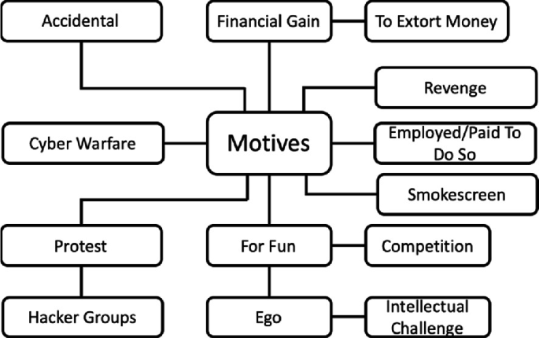

Slide 55
Types of Cyber Attacks
A cyber-attack is an exploitation of computer systems and networks. It uses malicious code to alter computer code, logic or data and lead to cybercrimes, such as information and identity theft.
Cyber-attacks can be classified into the following categories:
1) Web-based attacks
2) System-based attacks

Slide 56
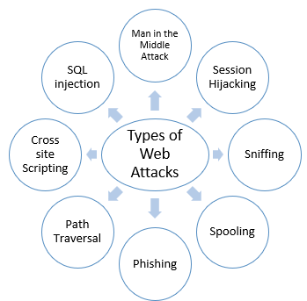
Web-based attacks

Slide 57
1. Injection attacks
It is the attack in which some data will be injected into a web application to manipulate the application and fetch the required information.
Example- SQL Injection, code Injection, log Injection, XML Injection etc.
2. DNS Spoofing
DNS Spoofing is a type of computer security hacking. Whereby a data is introduced into a DNS resolver's cache causing the name server to return an incorrect IP address, diverting traffic to the attackers computer or any other computer.
The DNS spoofing attacks can go on for a long period of time without being detected and can cause serious security issues.

Slide 58
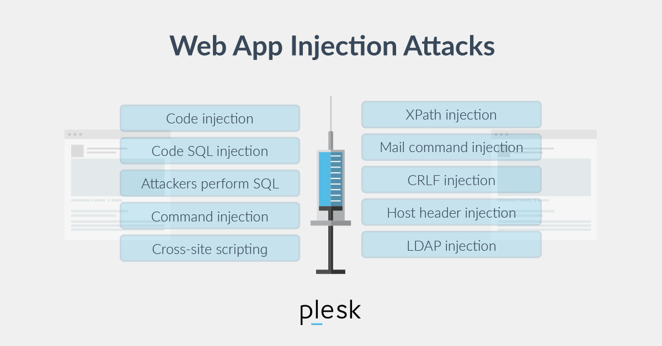

Slide 59
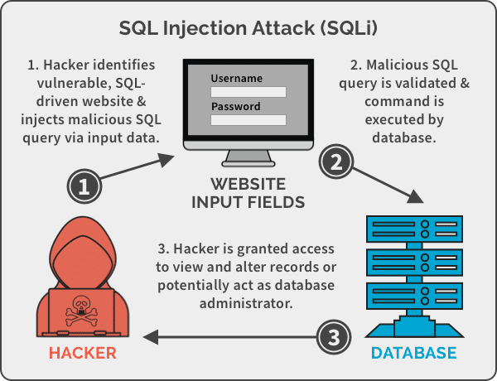

Slide 60
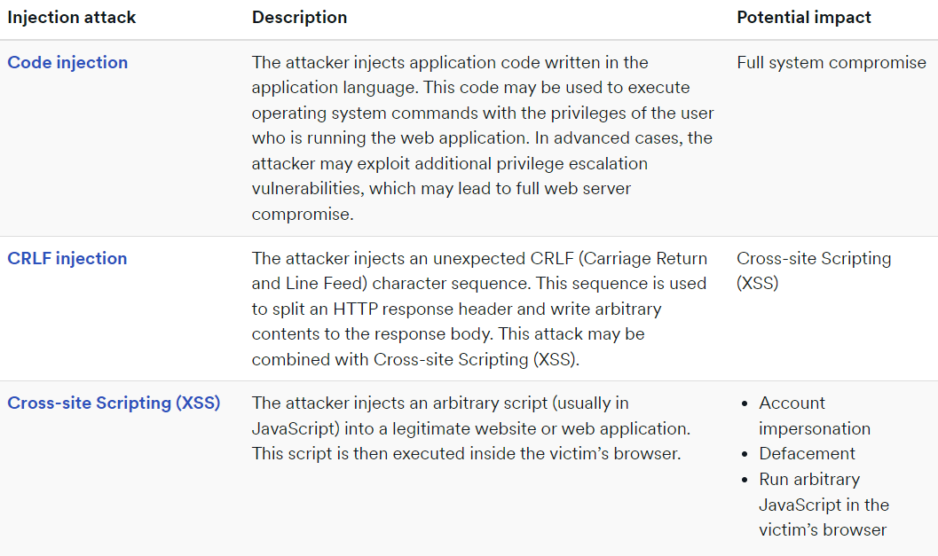

Slide 61
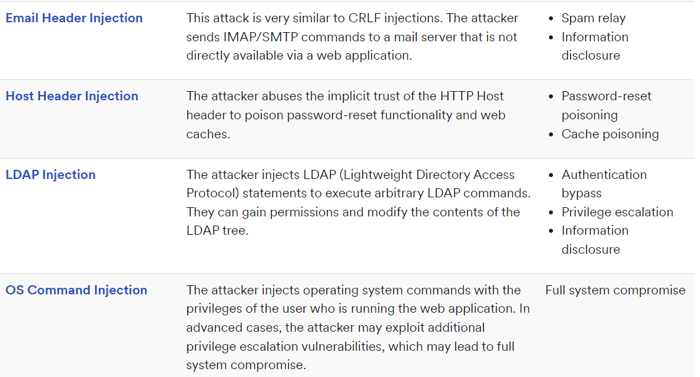

Slide 62
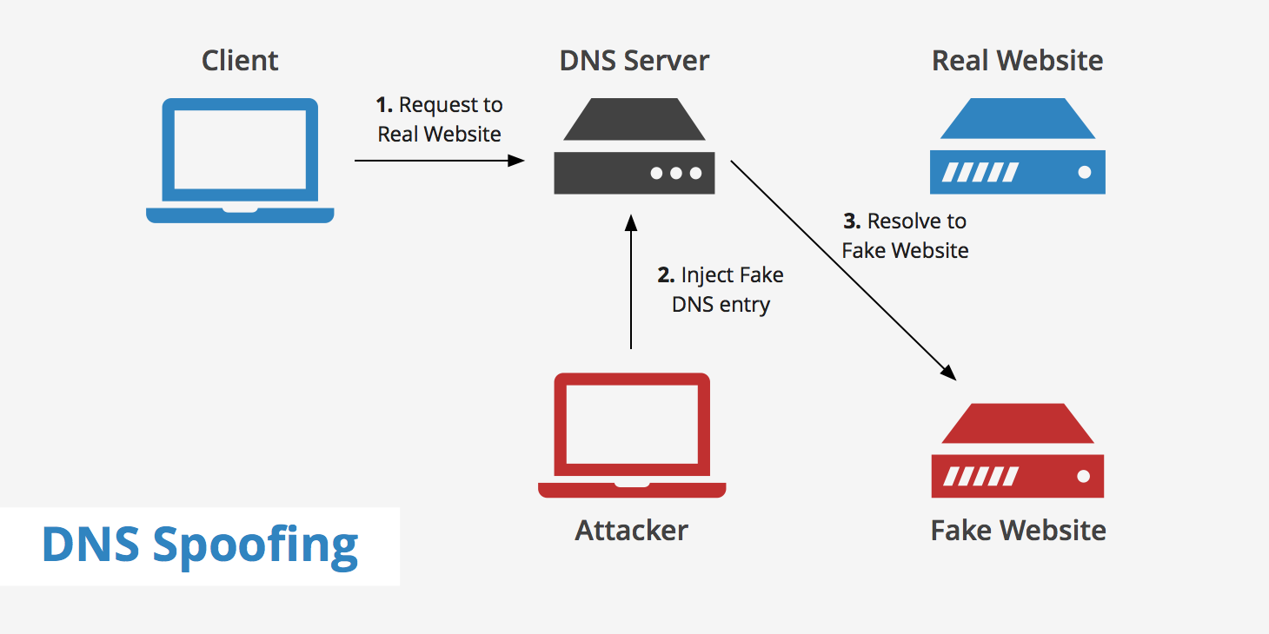
DNS Spoofing

Slide 63
3. Session Hijacking
It is a security attack on a user session over a protected network. Web applications create cookies to store the state and user sessions. By stealing the cookies, an attacker can have access to all of the user data.
4. Phishing
Phishing is a type of attack which attempts to steal sensitive information like user login credentials and credit card number. It occurs when an attacker is masquerading as a trustworthy entity in electronic communication.

Slide 64
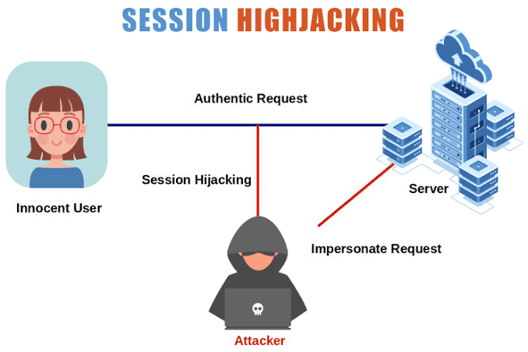

Slide 65
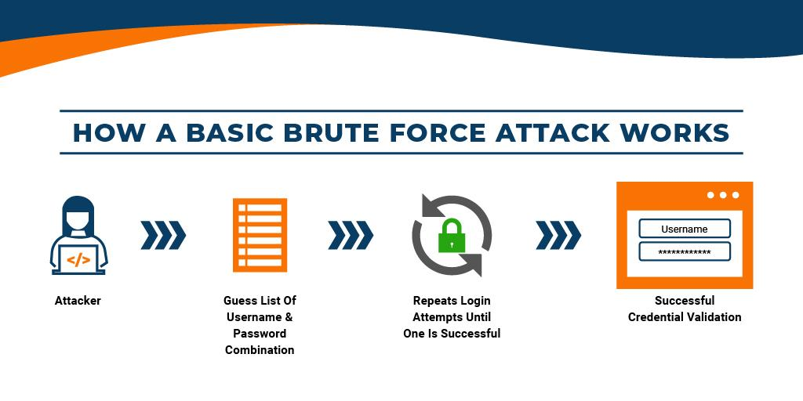
5. Brute force
It is a type of attack which uses a trial and error method. This attack generates a large number of guesses and validates them to obtain actual data like user password and personal identification number.
This attack may be used by criminals to crack encrypted data, or by security, analysts to test an organization's network security.

Slide 66
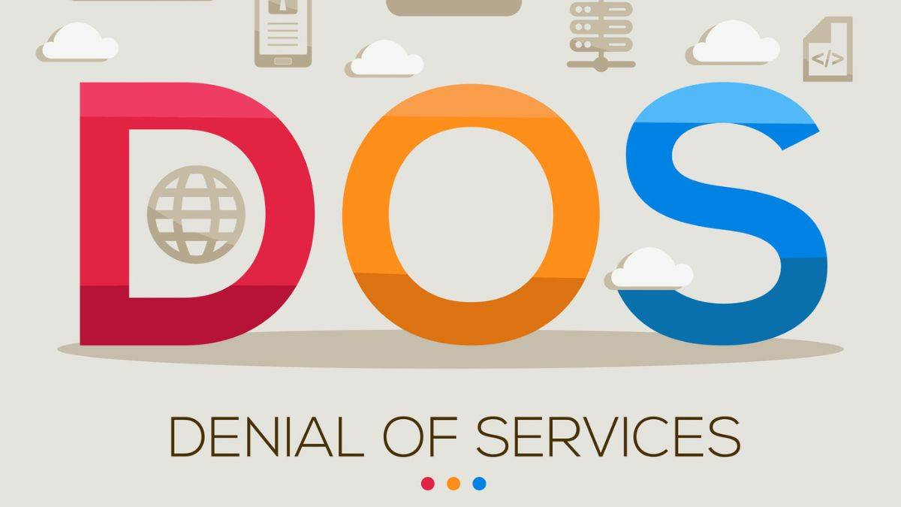
6. Denial of Service
It is an attack which meant to make a server or network resource unavailable to the users. It accomplishes this by flooding the target with traffic or sending it information that triggers a crash. It uses the single system and single internet connection to attack a server. It can be classified into the following-
Volume-based attacks- Its goal is to saturate the bandwidth of the attacked site, and is measured in bit per second.
Protocol attacks- It consumes actual server resources, and is measured in a packet. Application layer attacks- Its goal is to crash the web server and is measured in request per second.

Slide 67
7. Dictionary attacks
This type of attack stored the list of a commonly used password and validated them to get original password.
8. URL Interpretation
It is a type of attack where we can change the certain parts of a URL, and one can make a web server to deliver web pages for which he is not authorized to browse.
9. File Inclusion attacks
It is a type of attack that allows an attacker to access unauthorized or essential files which is available on the web server or to execute malicious files on the web server by making use of the include functionality.

Slide 68
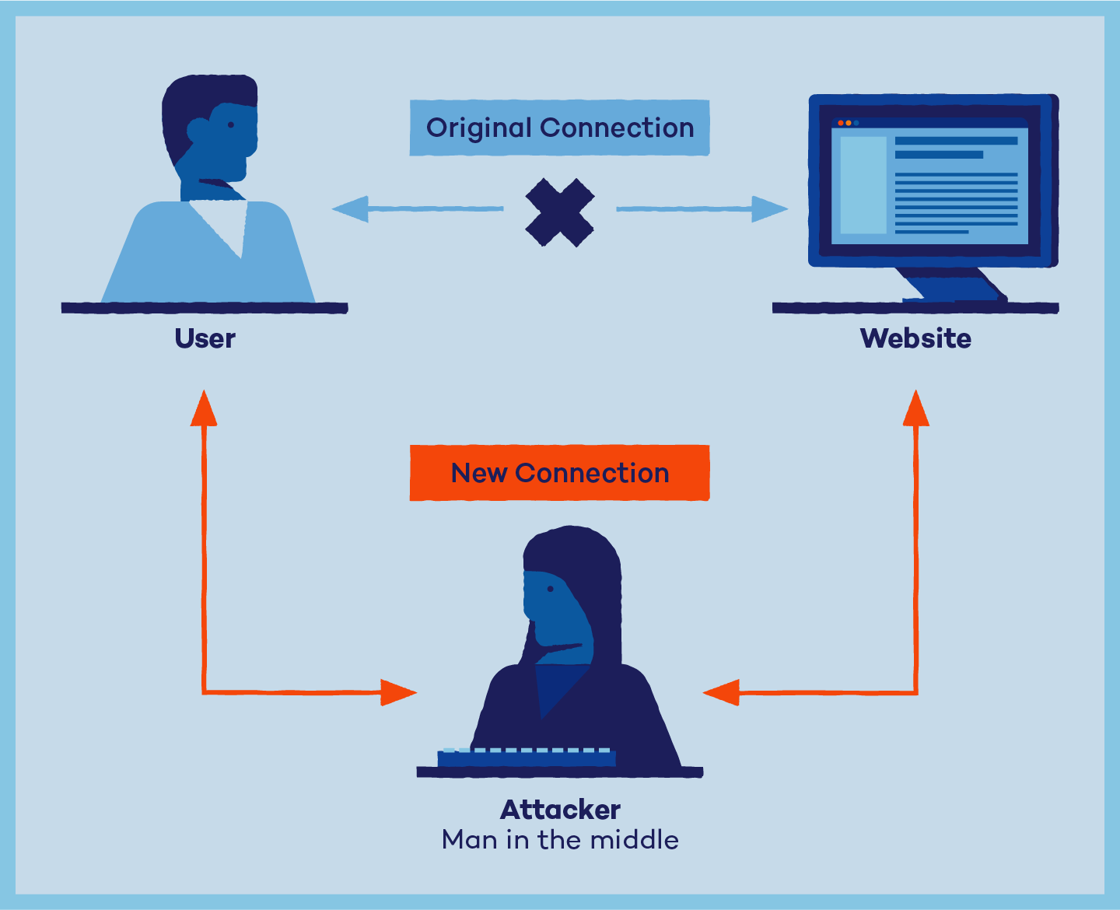
10. Man in the middle attacks
It is a type of attack that allows an attacker to intercepts the connection between client and server and acts as a bridge between them. Due to this, an attacker will be able to read, insert and modify the data in the intercepted connection.

Slide 69
System-based attacks
Virus
It is a type of malicious software program that spread throughout the computer files without the knowledge of a user. It is a self-replicating malicious computer program that replicates by inserting copies of itself into other computer programs when executed. It can also execute instructions that cause harm to the system.
Worm
It is a type of malware whose primary function is to replicate itself to spread to uninfected computers. It works same as the computer virus. Worms often originate from email attachments that appear to be from trusted senders.

Slide 70
Trojan horse
It is a malicious program that occurs unexpected changes to computer setting and unusual activity, even when the computer should be idle. It misleads the user of its true intent. It appears to be a normal application but when opened/executed some malicious code will run in the background.
Backdoors
It is a method that bypasses the normal authentication process. A developer may create a backdoor so that an application or operating system can be accessed for troubleshooting or other purposes.

Slide 71
Bots
A bot (short for "robot") is an automated process that interacts with other network services. Some bots program run automatically, while others only execute commands when they receive specific input. Common examples of bots program are the crawler, chatroom bots, and malicious bots.

Slide 72
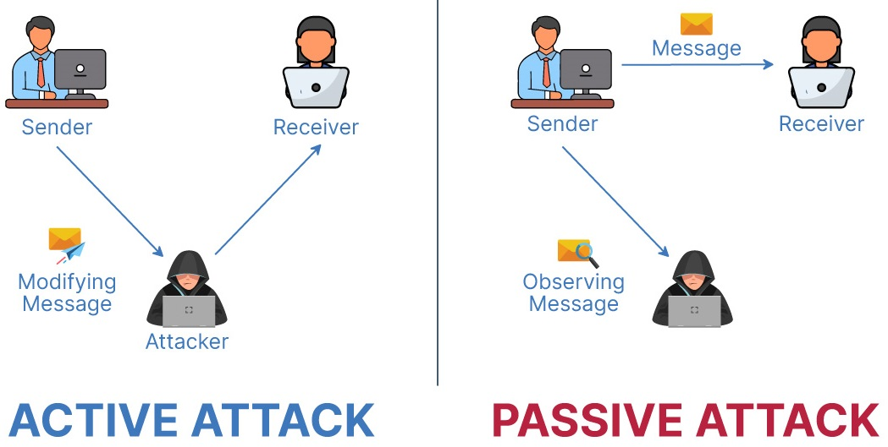
Active attacks: An active attack is a network exploit in which a hacker attempts to make changes to data on the target or data en route to the target.
Passive Attacks: Passive attacks are relatively scarce from a classification perspective, but can be carried out with relative ease, particularly if the traffic is not encrypted.

Slide 73
Types of Active attacks
Masquerade: in this attack, the intruder pretends to be a particular user of a system to gain access or to gain greater privileges than they are authorized for. A masquerade may be attempted through the use of stolen login IDs and passwords, through finding security gaps in programs or through bypassing the authentication mechanism.
Session replay: In this type of attack, a hacker steals an authorized user’s log in information by stealing the session ID. The intruder gains access and the ability to do anything the authorized user can do on the website.

Slide 74
Message modification: In this attack, an intruder alters packet header addresses to direct a message to a different destination or modify the data on a target machine.
In a denial of service (DoS) attack, users are deprived of access to a network or web resource. This is generally accomplished by overwhelming the target with more traffic than it can handle.
In a distributed denial-of-service (DDoS) exploit, large numbers of compromised systems (sometimes called a botnet or zombie army) attack a single target.

Slide 75
Types of Passive attacks
Eavesdropping (tapping): the attacker simply listens to messages exchanged by two entities. For the attack to be useful, the traffic must not be encrypted. Any unencrypted information, such as a password sent in response to an HTTP request, may be retrieved by the attacker.
Traffic analysis: the attacker looks at the metadata transmitted in traffic in order to deduce information relating to the exchange and the participating entities, e.g. the form of the exchanged traffic (rate, duration, etc.). In the cases where encrypted data are used, traffic analysis can also lead to attacks by cryptanalysis, whereby the attacker may obtain information or succeed in unencrypting the traffic.

Slide 76
Software Attacks:
Malicious code (sometimes called malware) is a type of software designed to take over or damage a computer user's operating system, without the user'sknowledge or approval. It can be very difficult to remove and very damaging. Commonmalware examples are listed in the following table:

Slide 77
Hardware Attacks
Common hardware attacks include:
Manufacturing backdoors, for malware or other penetrative purposes; backdoors aren’t limited to software and hardware, but they also affect embedded radio- frequency identification (RFID) chips and memory
Eavesdropping by gaining access to protected memory without opening other hardware
Inducing faults, causing the interruption of normal behavior
Hardware modification tampering with invasive operations
Backdoor creation; the presence of hidden methods for bypassing normal computer authentication systems
Counterfeiting product assets that can produce extraordinary operations and those made to gain malicious access to systems.

Slide 78
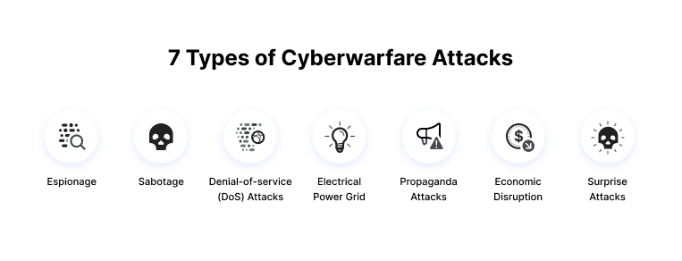
Cyber Warfare
Cyber warfare typically involves a nation-state perpetrating cyber attacks on another, but in some cases, the attacks are carried out by terrorist organizations or non-state actors seeking to further the goal of a hostile nation.
There are several examples of alleged cyber warfare in recent history, but there is no universal, formal, definition for how a cyber attack may constitute an act of war.

Slide 79
Security Policies
Security policies are a formal set of rules which is issued by an organization to ensure that the user who are authorized to access company technology and information assets comply with rules and guidelines related to the security of information.
A security policy also considered to be a "living document" which means that the document is never finished, but it is continuously updated as requirements of the technology and employee changes.

Slide 80
Need of Security policies
1) It increases efficiency.
2) It upholds discipline and accountability
3) It can make or break a business deal
4) It helps to educate employees on security literacy

Slide 81
Virus and Spyware Protection policy:
It helps to detect threads in files, to detect applications that exhibits suspicious behavior.
Removes, and repairs the side effects of viruses and securityrisks byusing signatures.
Firewall Policy:
It blocks the unauthorized users from accessing the systems and networks that connect to the Internet.
It detects the attacks bycybercriminals and removes the unwanted sources of network traffic.

Slide 82
Intrusion Prevention policy:
This policy automatically detects and blocks the network attacks and browser attacks. It also protects applications from vulnerabilities and checks the contents of one or more data packages and detects malware which is coming through legal ways.

Slide 83
Application and Device Control:
This policy protects a system's resources from applications and manages the peripheral devices that can attach to a system.
The device control policy applies to both Windows and Mac computers whereas application control policy can be applied only to Windows clients.

